Slide 1
Connected Hearts
Houston Hackathon 2019
Danilo Martins
Diego Volpato
Vitor Henrique

Slide 2
The problem
Small donation center have better understanding of community necessities but might lack resources
Lack of communication among small donation nucleus around the city.
A not addressed need inside a community hardly finds help outside of it
Donors may not have time or means to transport their donations

Slide 3
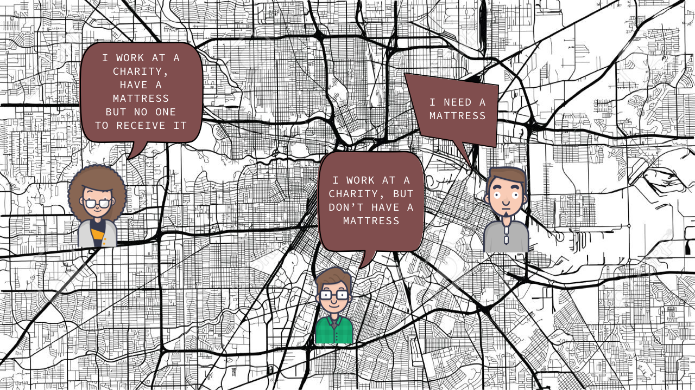

Slide 4
How Connected Hearts can help Houston
We connect local communities and create a network covering the whole city of Houston.
Allow volunteers to provide transportation for donated items.
Item search in all registered institutions.

Slide 5
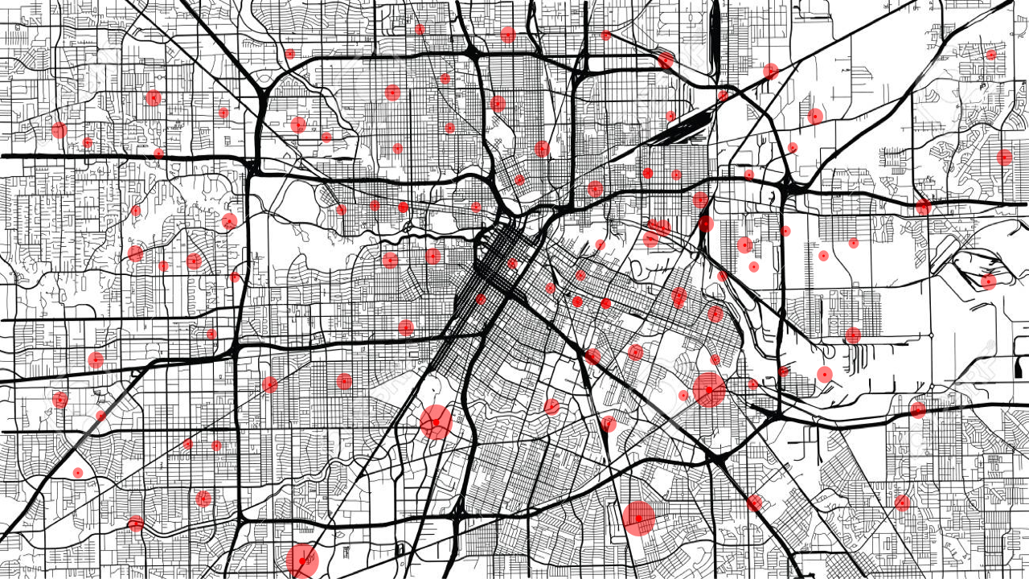

Slide 6
Demo
http://192.168.1.144:8000/

Slide 7
Project Storyline
Brainstorm of issues and ideas
Lean canvas
Discussions of Use Cases and Features
Structure of the System Architecture
Development of MVP (Minimum Value Product)

Slide 8
The future of Connected Hearts
Complete of the main stream use case, test and deployment
Register local charity institutions

Slide 9
The future of Connected Hearts
Search items in inventory
Send message to volunteers nearby that an item is available to pickup
Bar code scanning
Recommend donation pickup bundle to optimize transportation
Tax report for the donnors
Map (GIS) showing pickup places and destinations
Automated matching of current inventory and requested items

